Slide 1
Bulgarian Small and Medium Enterprise Promotion Agency
Your reliable partner in Bulgaria

Slide 2
The Bulgarian SMEs Promotion Agency
About BSMEPA
The Bulgarian Small and Medium Enterprises Promotion Agency (BSMEPA) was established in 2004 under the Ministry of Economy and Energy of Republic of Bulgaria.
BSMEPA’s role:
To be coordinating authority between public administration, business and NGO’s
To be entrepreneurs’ partner for successful business development and strengthening their competitiveness

Slide 3
BSMEPA functions
SMEs Support for innovative and technological development
Participation in international networks
Trade Capacity building and Promotion of SMEs Internationalization
Partnership with NGOs

Slide 4
Information/ Consulting Services
Specific marketing and analytical information:
By sectors and product groups
Target international markets
Distribution channels
Specific legislation requirements

Slide 5
National Export Internet Portal
/
www.export.government.bg
Data Base of Bulgarian companies with export potential
Access to information and services
Companies matchmaking
Marketing researches, economic analysis and reports
Actual trade and market information from the Bulgarian commercial and economic offices abroad
Export strategies and policies for the priority economic sectors
Information for funding sources

Slide 6
Seminars and Training Courses for SMEs
Introduction seminars - increasing the knowledge and capacity of Bulgarian companies to export on international markets
Informational seminars – educating SMEs on all existing instruments for promoting export, managed by the government institutions
Specialized seminars for promoting the export in the priority sectors

Slide 7
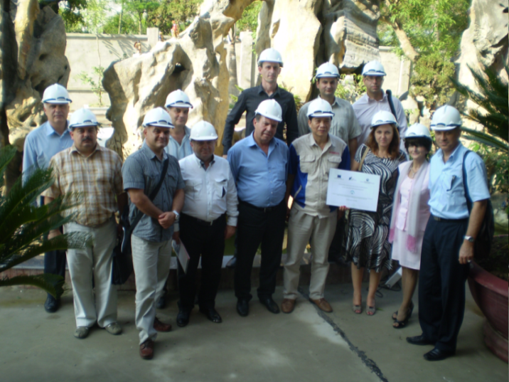
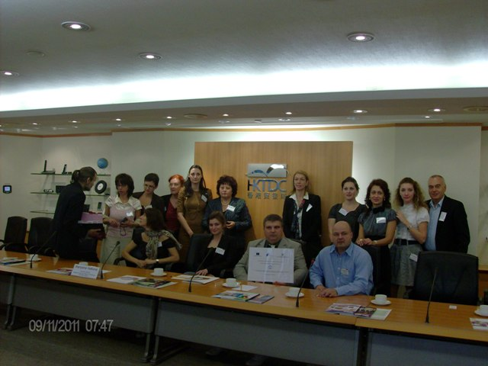
Trade Missions and B2B Forums in Bulgaria and Abroad
Organization of :
Trade missions in EU member states
Trade missions in third countries
International Forums in Bulgaria
Support for the participants:
Travel costs
accommodation
on-site logistics
all matchmaking event costs

Slide 8
Organization of promotional events
Organization of National stands at International fairs and exhibitions
Support for the participants:
Exhibition area
stands construction
furniture and equipment
exhibitors catalogue
registration fees
events participation

Slide 9
National Innovation Fund
Established by Act № 723 of 8 September 2004 of the Council of Ministers on the adoption of the Innovation Strategy of the Republic of Bulgaria and measures for its implementation
According to the Innovation Strategy for Smart Specialization of the Republic of Bulgaria 2014 - 2020, adopted by Act № 761 of 6 November 2014 of the Council of Ministers, NIF is one of the tools for the implementation of the innovation strategy

Slide 10
National Innovation Fund
The main objective of the Fund is to promote scientific research and development activities of enterprises and to stimulate cooperation between science and business.
Direct objectives:
to increase the volume of production;
to improve the quality of goods, services or processes;
to reduce the usage of resources;
to increase investment in efficient enterprises

Slide 11
Type of projects
Research development projects - focused on technological development of new products, processes, services or on a substantial improvement in existing products, processes or services
Maximum grant - 500 000 BGN
Deadline for completion of the project - 18 months
Additional benefits for SMEs and close cooperation!
Not eligible for funding to complete development, reaching out to
a market ready product, service or process!

Slide 12
Innovation
Product
Technology
Service
1 year
2 year
3 year
4 year
5 year
Commercialization or internal corporate implementation to two years after project completion

Slide 13
Eligible costs
Personnel costs
Costs of Depreciation of tools / equipment
Costs of external services
Costs of materials and supplies
Costs of travel abroad only if the project participant partner registered in another Member - State of the EEA

Slide 14
APPLICATION AND PERFORMANCE
COMPETITION SESSION
EVALUATION
NEGOTIATION
PERFORMANCE
REPORTING
MONITORING AND VERIFICATION
PAYMENT

Slide 15
Competition session analysis
Competition session | Number of Contracts | Agreed subsidy (in BGN) | Paid subsidy (in BGN)
І (2005) | 43 | 6 700 000 | 4 254 634
ІІ (2005) | 67 | 8 300 000 | 4 143 267
ІІІ (2006) | 108 | 16 600 000 | 8 128 018
ІV (2006) | 91 | 16 900 000 | 8 754 447
V (2008) | 60 | 12 000 000 | 7 243 842
VI (2012) | 36 | 9 110 755 | 5 910 718 Data as of: 31.08.2015
VII (2014) | 50 | 9 718 944 | 6 292 133 Data as of: 31.08.2015
TOTAL: | 455 | 79 329 699 | 44 727 059
EUROSTARS | 3 | 1 261 990 | 129 937 Data as of: 31.08.2015

Slide 16
Competition session analysis
(I-V)

Slide 17
Successfully implemented projects

Slide 18
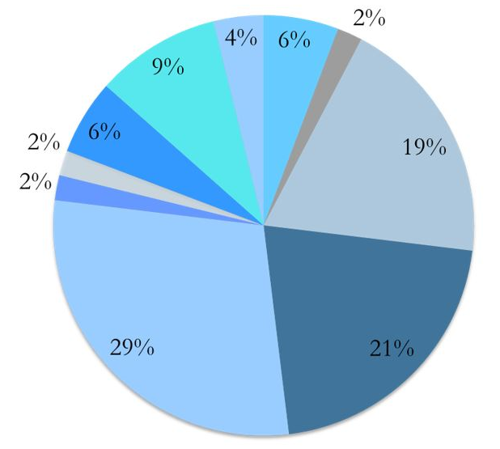
Sectors
Biotechnology/ cosmetic products
Water supply
Electronics
Machinery engineering
ICT
Furniture
Art

Slide 19
7-th Competition session results (2014)
50 signed contracts with total value 15 950 194,21 BGN;
Agreed subsidy – 9 718 944,24 BGN;
44 research and development projects and 6 technical feasibility projects;
13 projects with close cooperation with scientific organization - 25% of all approved;
39 projects coordinated by SMEs - 78% of the approved;
Beneficiaries from 20 cities

Slide 20
What’s ahead?
Announcement of the Eighth competition session of the NIF
Updating the rules for management of the National Innovation Fund after the adoption of Regulation 651/2014 of the European Commission, which regulates state aid for research and development and innovation.

Slide 21
Thank you for your attention!
BULGARIAN SMALL AND MEDIUM ENTERPRISES PROMOTION AGENCY
2-4, Lege Str., Sofia 1000, Bulgaria
Phone.: +359 (02) 940 79 40, Fax: +359 (02) 940 79 93
E-mail: office@sme.government.bg
www.sme.government.bg

